Slide 1
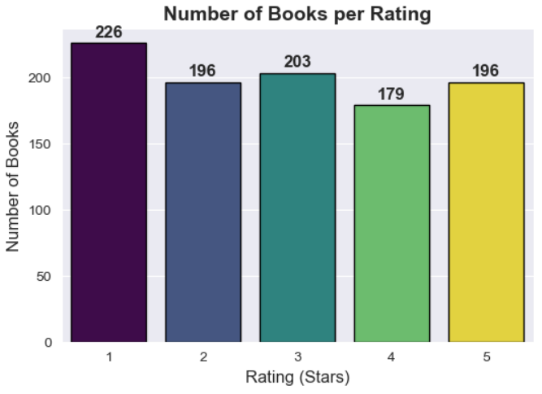
Insight
The distribution of book ratings indicates a significant proportion of 1-star reviews (226), suggesting potential issues with content quality, audience alignment, or customer expectations that may require strategic intervention.

Slide 2
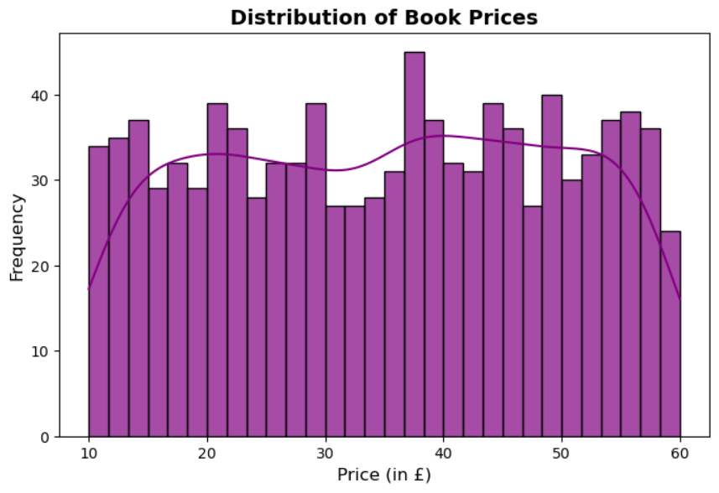
Insight
Book prices are evenly distributed between £10 and £60, with multiple peaks indicating distinct price categories. The absence of long tails suggests no extreme outliers.

Slide 3
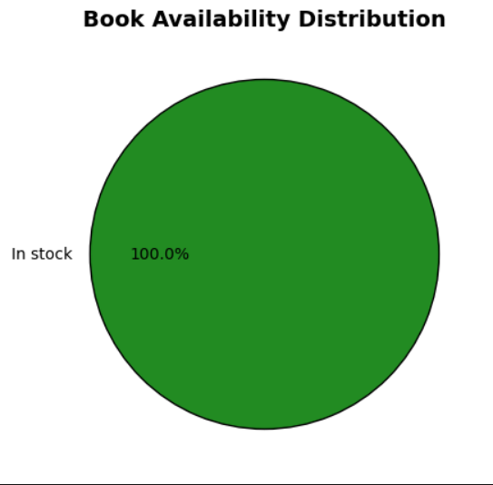
Insight
All books being in stock indicates efficient inventory management or potentially low demand.

Slide 4
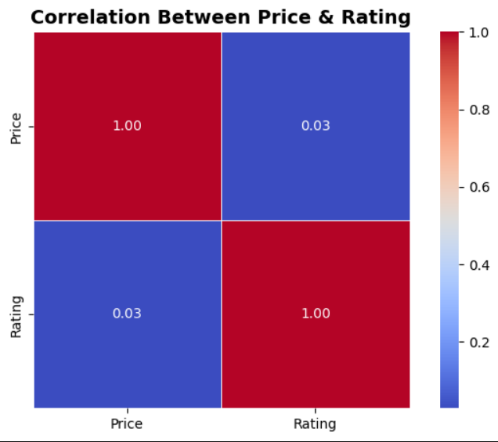
Insight
The near-zero correlation (0.03) between price and rating suggests that book prices have no significant impact on customer ratings.

